Slide 1
Introduction to Machine Translation
SIU Sai Cheong
School of Translation
Hang Seng Management College

Slide 2
Outline
Machine translation (MT) and translation technology
Rule-based Machine Translation (RBMT)
Example-based Machine Translation (EBMT)
Statistical Machine Translation (SMT)
Neural Machine Translation (NMT)
MT Skills

Slide 3
Topics
Machine translation (MT) and translation technology
Rule-based Machine Translation (RBMT)
Example-based Machine Translation (EBMT)
Statistical Machine Translation (SMT)
Neural Machine Translation (NMT)
MT Skills

Slide 4
Machine Translation (MT)
Automatic Translation System
ST
TT

Slide 5
Translation Technology
Translation Technology
Machine Translation (MT)
Computer-aided Translation (CAT)
Electronic Dictionaries
Corpora and Concordancers
Translation Memory (TM)
Terminology Databases
Text Translation
Speech Translation
Automatic Translation
Interactive Translation

Slide 6
Google Translate and Instant Camera Translation
https://www.youtube.com/watch?v=06olHmcJjS0
iTranslate Voice
http://vimeo.com/86562665
ili
https://www.youtube.com/watch?v=rIiGyn_HfcI

Slide 7
Topics
Machine translation (MT) and translation technology
Rule-based Machine Translation (RBMT)
Example-based Machine Translation (EBMT)
Statistical Machine Translation (SMT)
Neural Machine Translation (NMT)
MT Skills

Slide 8
Rule-based Machine Translation (RBMT)
Direct MT
Transfer MT

Slide 9
Direct MT
This is considered to be the first generation of MT systems.
The ST is treated as a string of words. The SL words are then replaced by TL words, and the TL words are reordered.

Slide 10
Direct MT
ST
1. Segmentation
2. Tokenization
3. Lemmatization
4. POS-tagging
5. Replacement
6. Modification: Reordering / Addition /
Omission
TT

Slide 11
Segmentation
the process of splitting a text into sentences
Tom was a student. He went to school by bus. He played football with them.
Tom was a student.
He went to school by bus.
He played football with them.

Slide 12
Tokenization
the process of dividing a text into words
He played football with them.
He
played
football
with
them
.

Slide 13
Lemmatization
the process of grouping the identical, related or inflected forms of a word together as a single item (lemma)
Example: do, does, doing, did → do

Slide 14
POS-tagging
the process of assigning a part-of-speech (POS) to every lexical item in the input
He
play(ed)
football
with
them
Pronoun
Preposition
Noun
Verb

Slide 15
Replacement
the process of replacing the SL words with TL words
He (pronoun)
play(ed) (verb)
football (noun)
with (prep)
them
(pronoun)
他
（代名詞）
踢
（動詞）
足球 （名詞）
與
（介詞）
他們
（代名詞）

Slide 16
Reordering and Modification
the process of reordering the TL words and polishing the TT
他
（代名詞）
踢
（動詞）
足球 （名詞）
與
（介詞）
他們
（代名詞）
他
（代名詞）
與
（介詞）
他們
（代名詞）
踢
（動詞）
足球 （名詞）

Slide 17
Transfer MT
The basic idea: Analysis, Transfer and Generation
Input sentences are analyzed and translated into an abstract internal representation retaining their features in the SL.
The representation is transferred to a representation with the features in TL and generates the TT.

Slide 18
Transfer MT
ST
1. Segmentation
2. Tokenization
3. Lemmatization
4. POS-tagging
5. Parsing
6. Transfer
7. Generation
TT

Slide 19
Parsing
the process of analyzing the input and generating the SL representation (e.g., a parse tree) that identifies the function of each word/word group

Slide 20
Transfer
the conversion of the SL representation into its equivalent TL representation

Slide 21
Generation
the production of the TL text from the TL representation

Slide 22
An Example
ST: The boy went to Didneyland.
Case conversion: the boy went to didneyland.
Segmentation
<1> the boy went to didneyland.

Slide 23
An Example
Tokenization
<1> the
<2> boy
<3> went
<4> to
<5> didneyland
<6> .

Slide 24
An Example
Lemmatization
<1> the
<2> boy
<3> go (past tense)
<4> to
<5> didneyland
<6> .

Slide 25
An Example
POS-tagging
<1> the (definite article)
<2> boy (noun, singular)
<3> go (verb, past tense)
<4> to (preposition)
<5> didneyland (noun, singular)
<6> .

Slide 26
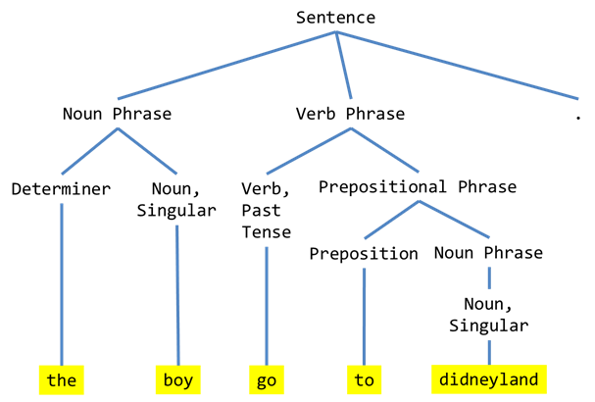
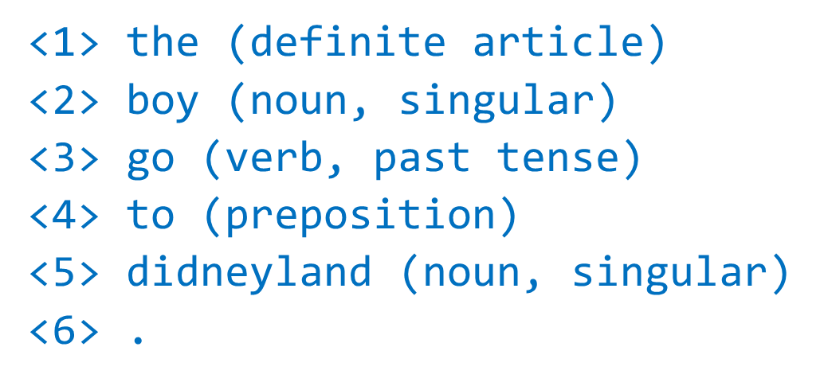
An Example
Parsing

Slide 27
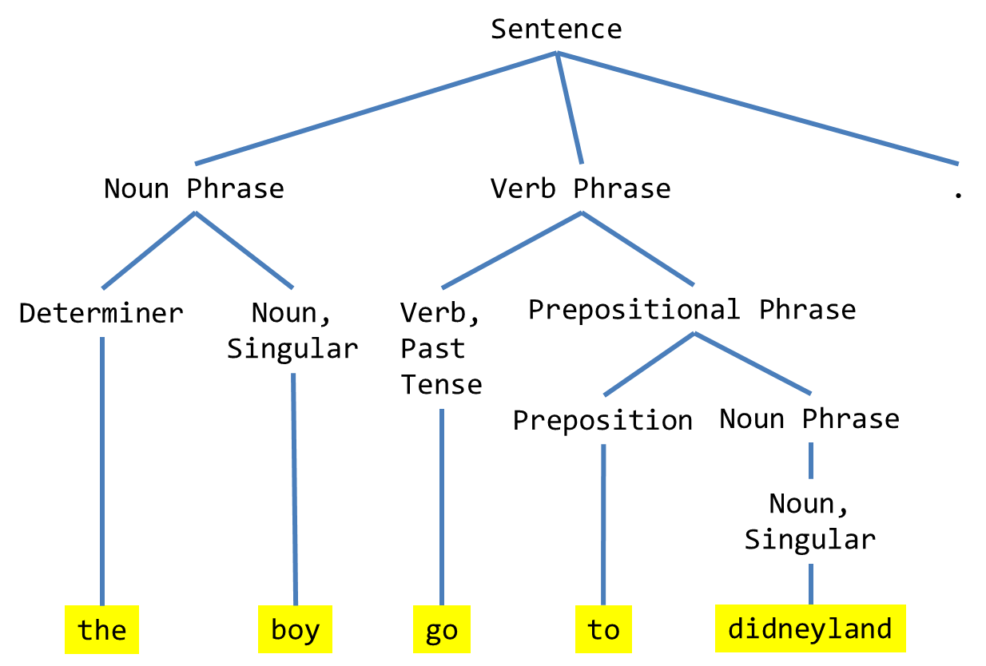
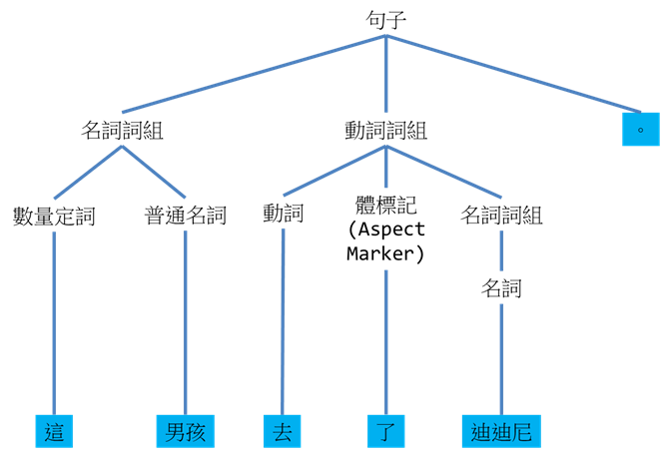
An Example
Transfer

Slide 28

An Example
Generation
這男孩去了迪迪尼。

Slide 29
Topics
Machine translation (MT) and translation technology
Rule-based Machine Translation (RBMT)
Example-based Machine Translation (EBMT)
Statistical Machine Translation (SMT)
Neural Machine Translation (NMT)
MT Skills

Slide 30
Example-based Machine Translation
An EBMT system translates by analogy. It requires a bilingual parallel corpus as its main knowledge base.
To do translation, the system retrieves and modifies the closest translation example(s) from the corpus.

Slide 31
Finding appropriate translation examples
Reordering the examples retrieved with the assistance of a language model

Slide 32
The best example?

Slide 34
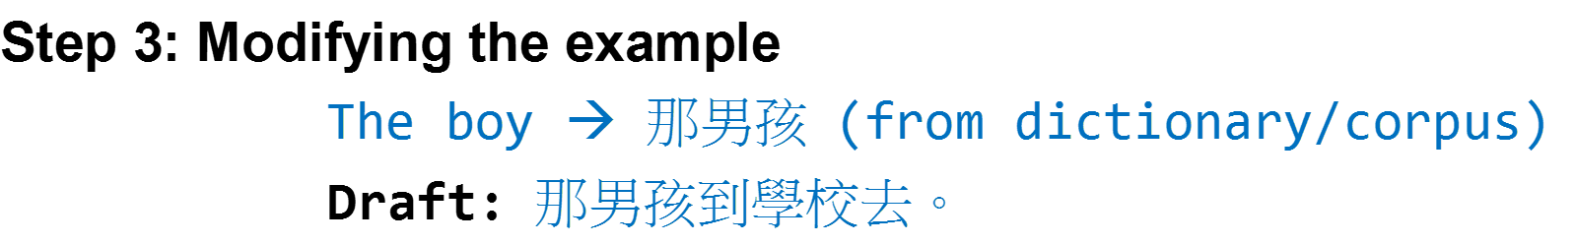
1. Dictionary/Rules:
The → 那
Boy → 男孩
2. Other examples
in the database:
A. By comparison
The boy is naughty.
那男孩真頑皮。
He didn’t see the boy.
他看不見那男孩。
B. By Word Alignment
The/boy/is/tall.
→ 那/男孩/長得/高。
3.
Translation Model:
P(The|那),
P(The|該),
P(boy|男孩),
P(boy|百厭星)…
4.
Hybrid Approach:
1 + 2 + 3

Slide 35
Topics
Machine translation (MT) and translation technology
Rule-based Machine Translation (RBMT)
Example-based Machine Translation (EBMT)
Statistical Machine Translation (SMT)
Neural Machine Translation (NMT)
MT Skills

Slide 36
Statistical Machine Translation
Stage 1: Training
A Bilingual Database with Probabilities
A Monolingual Database of TL Expressions with Probabilities
Find expressions that are most likely to be used in the translation
Find the TL word order that is most likely to be correct
ST
TT
Stage 2: Decoding

Slide 37
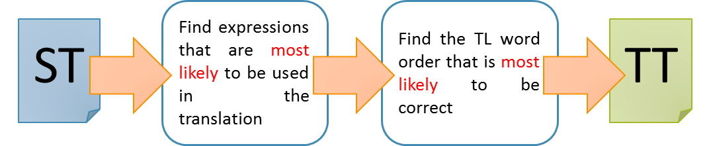
Translation Model
Language Model

Slide 38
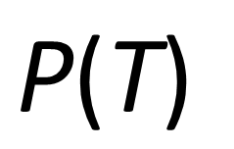
Language Model
Do you prefer fish ?
Elephants love her .
Give me fish .
Dogs love swimming .
We love dogs .
$$\text{P}\text{(}\text{T}\text{)}$$
Monolingual Corpus in the Target Language

Slide 39
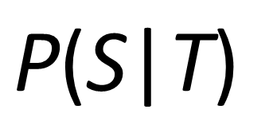
Translation Model
Source Language
我喜歡貓 。大象鍾意我 。人們喜歡狗 。他們嗜魚 。我們喜歡猴子 。你喜歡豬 。
Target Language
I love cats. Elephants love me. People love dogs. They prefer fish. We love monkeys. You prefer pigs.
$$\text{P}\text{(}\text{S}\text{|}\text{T}\text{)}$$
Bilingual Corpus

Slide 40
Monolingual (in TL)
Bilingual
Data
Tables

Slide 41
Dogs love elephants.
Dogs elephants love.
Love dogs elephants.
Love elephants dogs.
Elephants love dogs.
Elephants dogs love.
Dogs loves elephants.
Dogs elephants loves.
Loves dogs elephants.
Loves elephants dogs.
Elephants loves dogs.
Elephants dogs loves.
User’s Input
MT Output
狗喜歡大象。
Dogs love elephants.
Bilingual Table
Monolingual Table

Slide 42
Topics
Machine translation (MT) and translation technology
Rule-based Machine Translation (RBMT)
Example-based Machine Translation (EBMT)
Statistical Machine Translation (SMT)
Neural Machine Translation (NMT)
MT Skills

Slide 43
Traditional Approaches to Machine Translation
01
I go to school by bus.
我／去／學校／乘／公車／。
我乘公車去學校。
Rule-based Machine Translation
02
I go to school by bus.
I go to school by taxi. 我乘計程車去學校。
我乘公車去學校。
Example-based Machine Translation
03
Translation Model
P(“I”|“我”) x P(“go”|“去”) x ...
Language Model:
P(“我乘公車去學校”)
Statistical Machine Translation

Slide 44
New Approach: Neural Machine Translation
Deep Learning: the use of multiple layers of artificial neurons
Automatic feature engineering: Converting the input into an internal representation that captures the features of the input by using deep neural networks
Areas of Application: Speech recognition, handwriting recognition, image processing, and machine translation

Slide 45
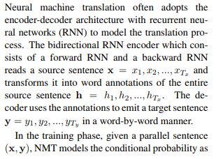
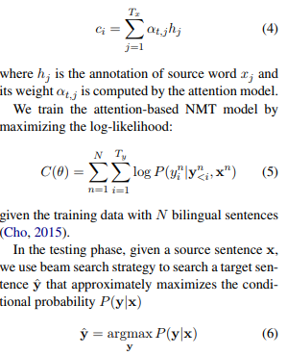
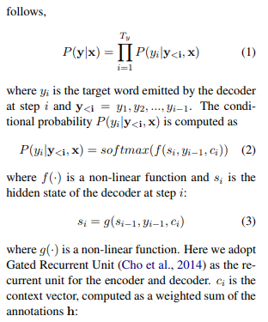
Neural Machine Translation
(http://aclweb.org/anthology/D17-1149)

Slide 46
Biological Neuron
dendrite
樹突
axon terminal
soma
細胞體
2
activation
“input”
from
other
neurons
axon 軸突
“output” to
other
neurons
1
3
nucleus
細胞核

Slide 47
Artificial Neuron
Input
1
Example: Adding (input value x weight)
Example: If the sum of the input > 0, the output = 1.
weight = 0.5
Output
0
weight = 0.2
Activation Function
1
Sum
(~soma)
(~axon)
weight = 0.3
Ans: 0.8
1
(~dendrites)

Slide 48
Artificial Neuron
0
1
0
1
A list of numbers
A number
1

Slide 49
Artificial Neural Network: Many Neurons
Input
Hidden
Output
Neuron
1
Neuron
2
1
1
0
0
1
1
1
0
0
1
0
1
…
…
…
Neuron n-1
Neuron
n

Slide 50
Artificial Neural Network
1
1
0
0
1
1
1
0
0
1
0
1
A number
A list of numbers
Another list of numbers
(more “meaningful”)
1

Slide 51
Artificial Neural Network and Image Processing
Probability
that the picture
is a …
0
1
0
1
0
1
1
0
0.55
0.300.10
0.05
cat
tiger
dog
man
Multi-class Classification

Slide 52
NMT as a Prediction Problem: Given X, what is the next word?
Given the following:
ST: I / go / to / school / by / bus / . /
TT: 我 / 乘
Which of the following is most likely to be the next word?
公車
火車
學校
咖啡
電腦
翻譯

Slide 53
Neural Machine Translation as Multi-class Classification
Probability
Of the next Chinese word
0
1
0
1
0
1
1
0
1
0
0
1
0
1
0
1
0
1
0
1
0
0.02
0.95
0.03
0
0
0
0
0
0
0
0
0
0
0
你
我
他
乘
走
跑
公車
計程車
火車
去
來
學校
公司
公園
Probability
that the picture
is a …
0
1
0
1
0
1
1
0
ST: I go to school by bus.
0.55
0.300.10
0.05
cat
tiger
dog
man

Slide 54
Neural Machine Translation
Probability
of the next Chinese word
0
0
1
0
1
0
0
0
1
0
0
1
0
1
0
1
0
1
0
1
0
0
1
0
1
0
1
1
0
1
0
0
1
0
1
0
1
0
1
0
1
0
0
1
0
0
0
0
0
0
0
0
0
0
0
0
0
0
0
0.96
0.03
0.01
0
0
0
0
0
0
0
0
你
我
他
乘
走
跑
公車
計程車
火車
去
來
學校
公司
公園
你
我
他
乘
走
跑
公車
計程車
火車
去
來
學校
公司
公園
0
1
0
1
0
1
1
0
ST: I go to school by bus.
TT:
我

Slide 55
Neural Machine Translation
Probability
of the next Chinese word
0
1
1
0
0
1
0
0
1
0
0
1
1
0
1
0
1
1
0
1
0
0
0
1
0
1
0
0
0
1
0
0
1
0
1
0
1
0
1
0
1
0
0
0
0
0.96
0.03
0.01
0
0
0
0
0
0
0
0
0
0
0
0
0
0
0.80
0.10
0.10
0
0
0
0
0
你
我
他
乘
走
跑
公車
計程車
火車
去
來
學校
公司
公園
你
我
他
乘
走
跑
公車
計程車
火車
去
來
學校
公司
公園
ST: I go to school by bus.
TT:
我乘

Slide 56
Neural Machine Translation
Probability
of the next Chinese word
0
1
1
1
1
1
1
1
1
1
0
1
0
1
1
0
0
1
1
1
0
0
0
1
0
1
0
0
0
1
0
0
1
0
1
0
1
0
1
0
1
0
0
0
0
0
0
0
0.80
0.10
0.10
0
0
0
0
0
0
0
0
0
0
0
0
0
0
0.75
0.25
0
0
0
你
我
他
乘
走
跑
公車
計程車
火車
去
來
學校
公司
公園
你
我
他
乘
走
跑
公車
計程車
火車
去
來
學校
公司
公園
ST: I go to school by bus.
TT:
我乘公車

Slide 57
Neural Machine Translation
Probability
of the next Chinese word
0
0
0
0
1
1
0
0
0
1
1
0
1
0
1
1
0
1
0
0
0
0
1
1
1
1
1
1
1
1
1
0
1
0
1
1
0
0
1
1
1
0
0
0
0
0
0
0
0
0
0
0.75
0.25
0
0
0
0
0
0
0
0
0
0
0
0
0
0
0.90
0.08
0.02
你
我
他
乘
走
跑
公車
計程車
火車
去
來
學校
公司
公園
你
我
他
乘
走
跑
公車
計程車
火車
去
來
學校
公司
公園
ST: I go to school by bus.
TT:
我乘公車去

Slide 58
Types of Neural Machine Translation
Encoder-decoder (Recurrent Neural Networks using Long-short Term Memory Cells or Gated Recurrent Units) with Attention (Bahdanau, Cho, & Bengio, 2014; Luong, Pham, & Manning, 2015; Wu et al., 2016)
Convolutional Neural Networks (Gehring et al., 2017)
Self-attentional Transformers (Vaswani et al., 2017)

Slide 59
Examples (since 2016)
Google Neural Machine Translation
Microsoft Translator: AI Chinese-English machine translation system (news translation) that can translate with the same accuracy as a human
Tencent: Conference Interpreting (Simultaneous transcription and translation)
Sogou: WMT 2017 News Translation Task (1st in Chinese-English Translation and 3rd in English-Chinese Translation)

Slide 60
Topics
Machine translation (MT) and translation technology
Rule-based Machine Translation (RBMT)
Example-based Machine Translation (EBMT)
Statistical Machine Translation (SMT)
Neural Machine Translation (NMT)
MT Skills

Slide 61
MT Skills
Editing: Pre-editing and Post-editing
Evaluation

Slide 62
Modes of Editing
Automatic Translation System
ST
TT
Intermediate Output
Final TT by the computer
Initial ST
Pre-editing
譯前編輯
Post-editing
譯後編輯

Slide 63
Example
申請期於十月二十日開始，至十一月二日晚上七時截止，在申請期開始前或截止時間後所遞交的申請表將不獲處理。

Slide 64
Example
Application forms will be closed from 20 October to 7 pm on November 2 and applications submitted before or after the application period will not be processed.
The application period begins on October 20 and ends at 7 pm on November 2. Applications submitted before or after the application period will not be processed.

Slide 65
Automatic Evaluation (1): Round-trip Translation
MT
Source Text
Target Text
Comparison
New Source Text
Similar → Better
Different → Worse
MT again

Slide 66


Automatic
Evaluation (2)
Source Text
How ☺
Machine Translation
Human Translation
Human Translation
Comparison

Slide 67
Thank you!

